Slide 1

ISEE Project – Team DroidKnights
Milestone #3 - Advanced Prototype

Slide 2
Contents
ISEE Project - Team DroidKnights
Milestone #3 - Advanced Prototype
01
03
01
02
The team
Software Architecture
Requirements
Members and their roles
Requirement analysis and user stories
04
05
06
System design
Working prototype
Context of use
User personal profiles
Activity diagram, class diagram
Working application video,screenshots

Slide 3





ISEE Project - Team DroidKnights
Milestone #3 - Advanced Prototype
Roles
Blog maintenance
Abhirup Roy
M. Sc. Digital Engineering
Indarapu Sreekar Kumar
M. Sc. Digital Engineering
Application
Development
User Stories, Activity diagram, Class diagram
Denzil Correa
M. Sc. Operations Research and Business Analytics
Anjan Chatterjee
M. Sc. Digital Engineering
Harshavardhan Reddy
M. Sc. Digital Engineering

Slide 4
02
Software Architecure
ISEE Project - Team DroidKnights
Milestone #3 - Advanced Prototype
Architecure used for organising code
Naming conventions

Slide 5
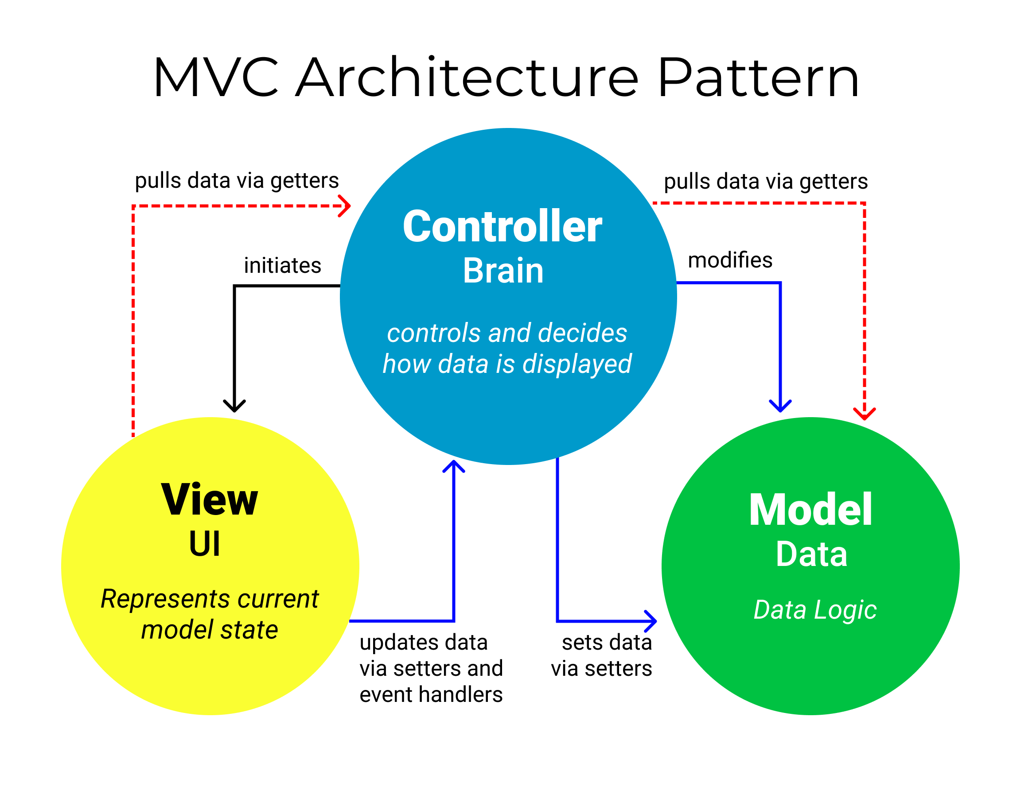
ISEE Project - Team DroidKnights
Milestone #3 - Advanced Prototype

Slide 6
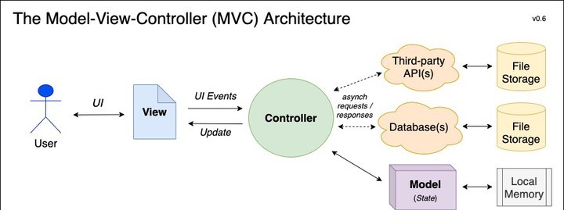
ISEE Project - Team DroidKnights
Milestone #3 - Advanced Prototype

Slide 7
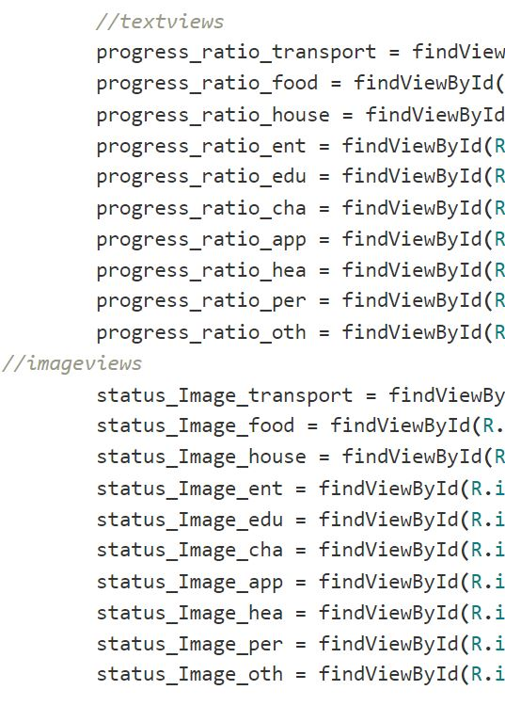
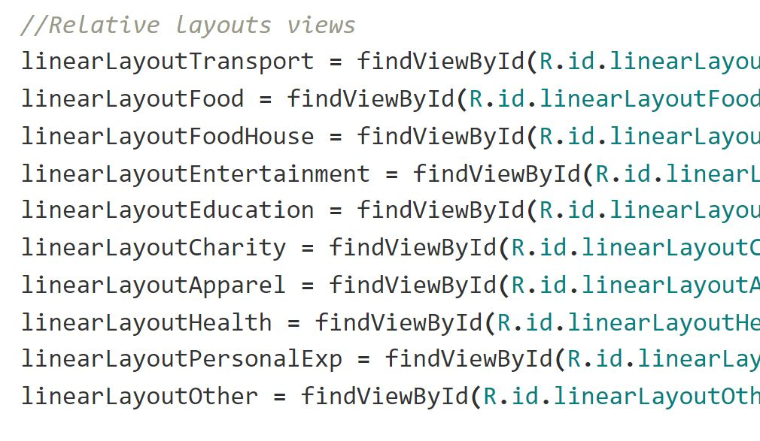
Naming conventions
ISEE Project - Team DroidKnights
Milestone #3 - Advanced Prototype
lowerCamelCase
Snake_case

Slide 8
03
Requirements
ISEE Project - Team DroidKnights
Milestone #3 - Advanced Prototype
Requirement analysis and user stories

Slide 9
Requirements
ISEE Project - Team DroidKnights
Milestone #3 - Advanced Prototype
Essential
Different categories
Add a date
Filters (e.g. by category, by month, payment option, amount of money)
Additional notes per entry (user-customizable)
How did I pay
Easy to enter numbers
Select currency in settings
Offline capability
Necessary
Icons
Deleting entries
Budget planning/thresholds
Repeated transactions
Password
Start screen does not indicate what this app is about
Access to contacts (e.g., If money lend to friend)
Nice to have
Show costs in chart
Help menu
Export/import data
Computing average (per day, per month)
Credit additional to debit
Currencies (plus conversion)
Several "projects"
Simple recommender
Notifications

Slide 10
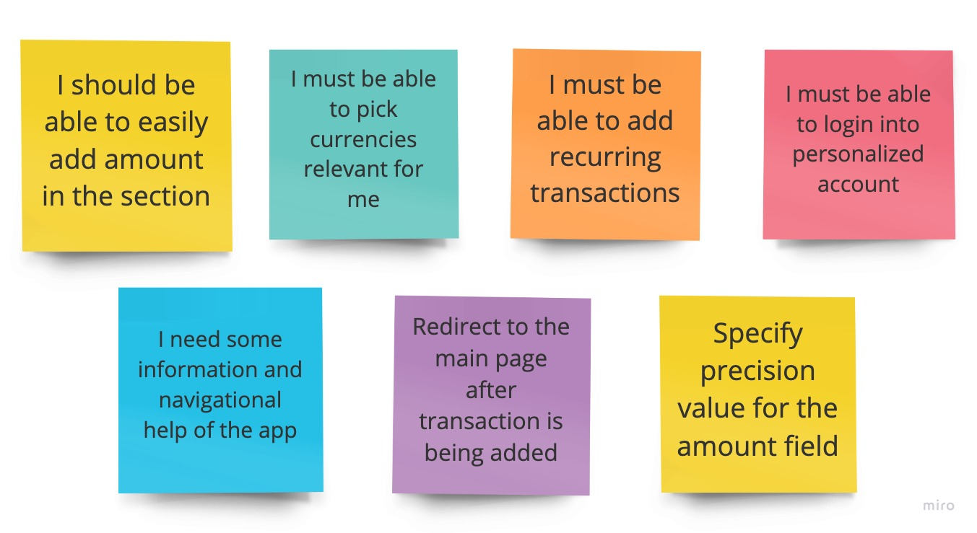
User stories
ISEE Project - Team DroidKnights
Milestone #3 - Advanced Prototype

Slide 11
04
Context of Use
ISEE Project - Team DroidKnights
Milestone #3 - Advanced Prototype
Profile of users who might be using our app

Slide 12
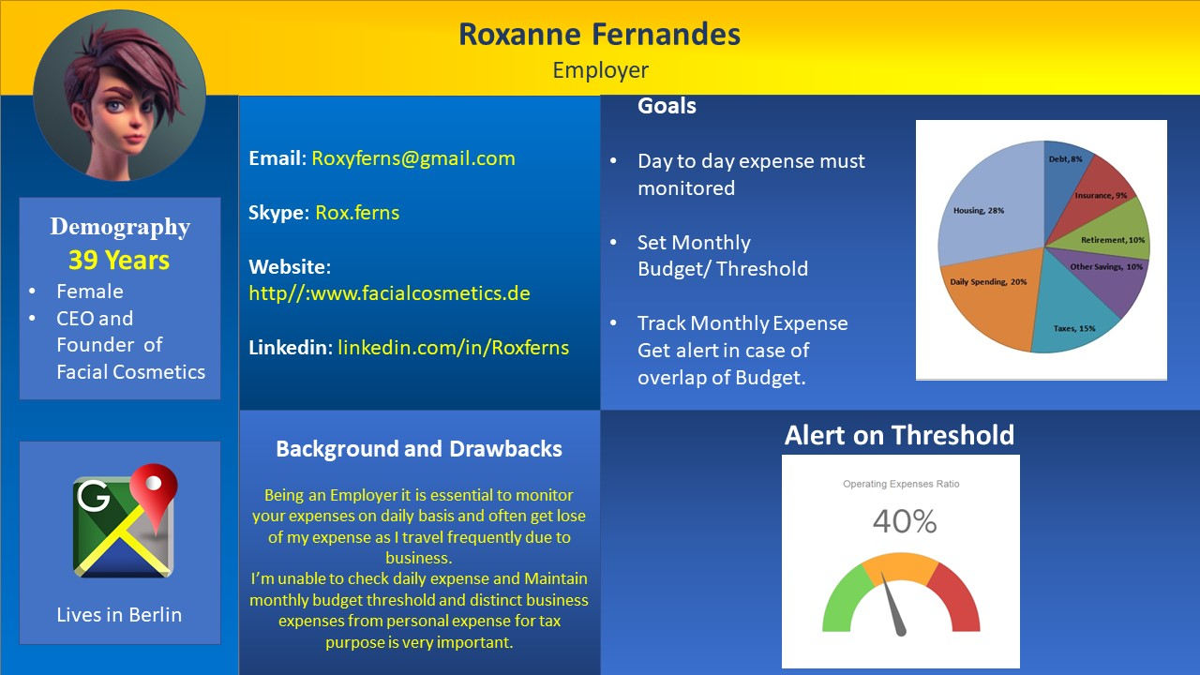
ISEE Project - Team DroidKnights
Milestone #3 - Advanced Prototype

Slide 13
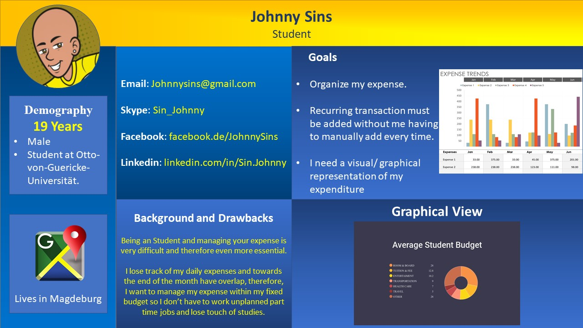
ISEE Project - Team DroidKnights
Milestone #3 - Advanced Prototype

Slide 14
05
System design
ISEE Project - Team DroidKnights
Milestone #3 - Advanced Prototype
Activity diagrams
Class diagrams

Slide 15
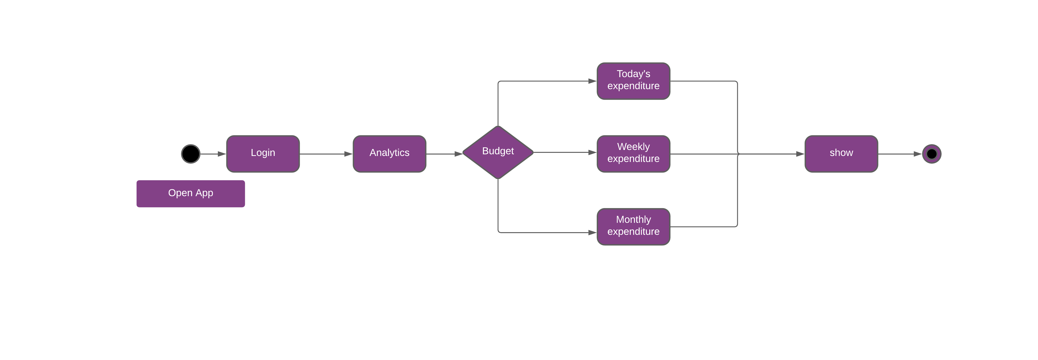
Activity Diagrams
ISEE Project - Team DroidKnights
Milestone #3 - Advanced Prototype

Slide 16
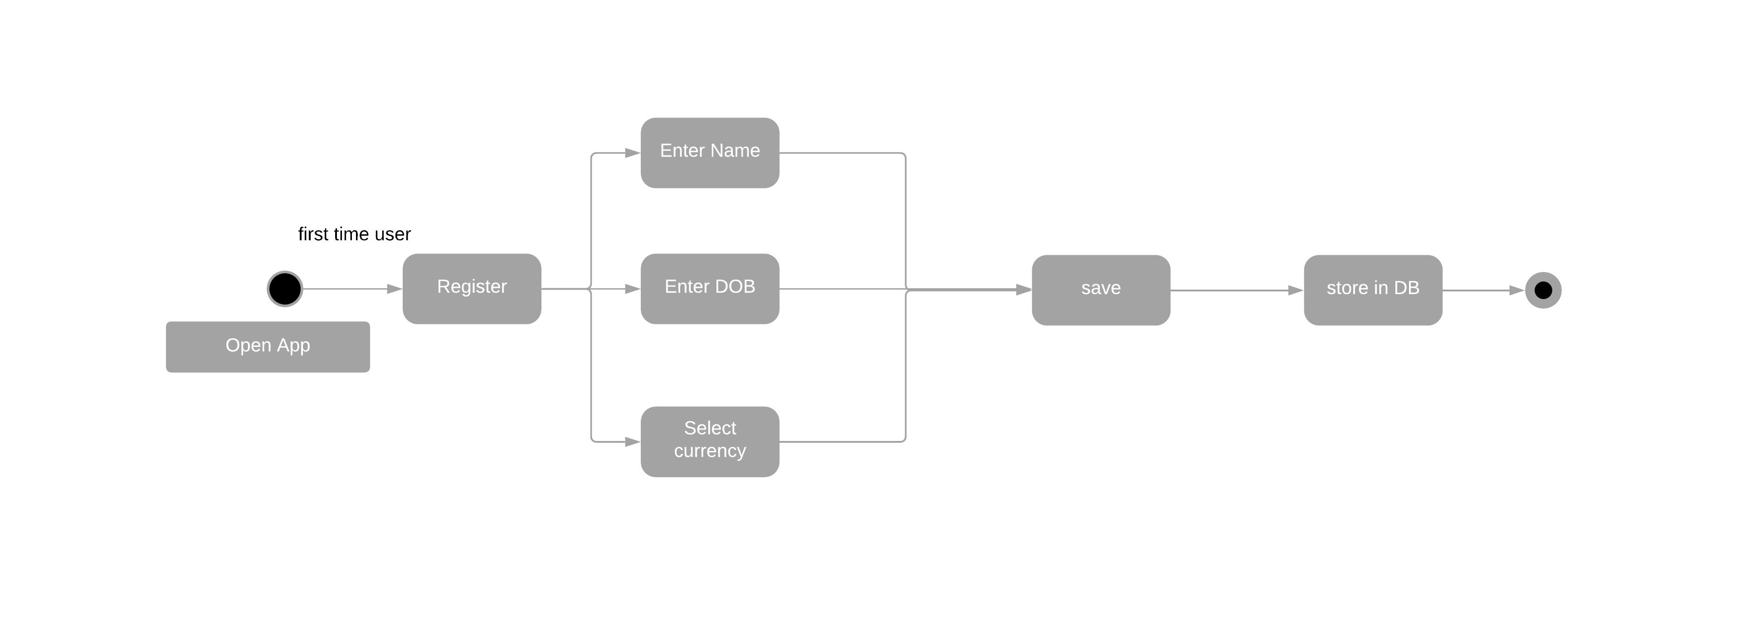
Activity Diagrams
ISEE Project - Team DroidKnights
Milestone #3 - Advanced Prototype

Slide 17
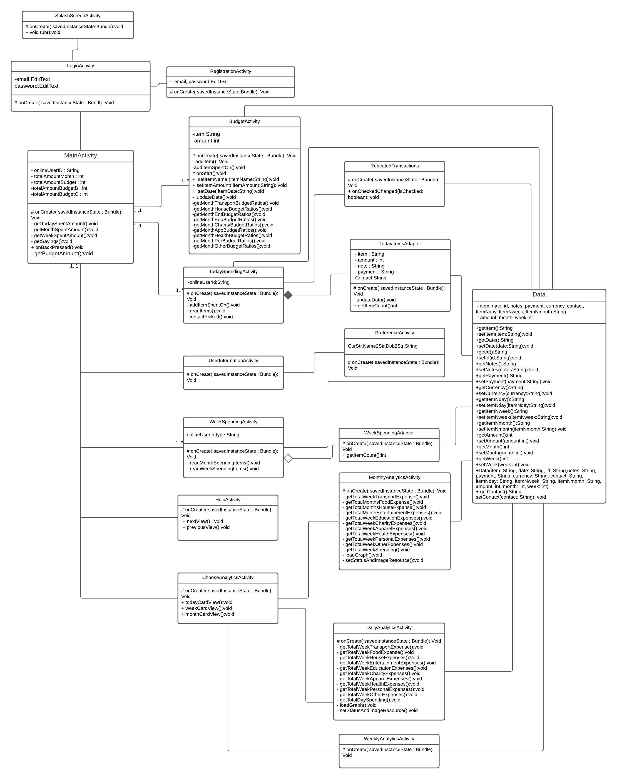
Class diagram
ISEE Project - Team DroidKnights
Milestone #3 - Advanced Prototype

Slide 18
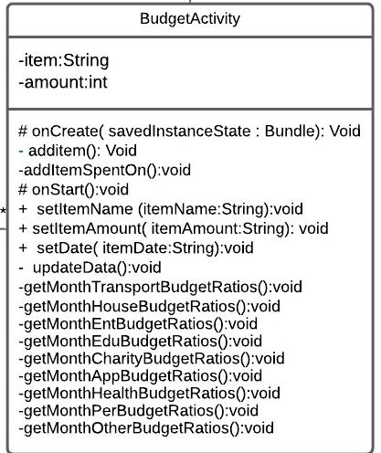
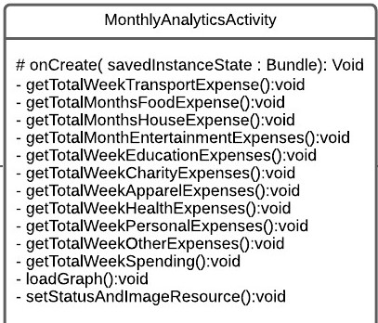
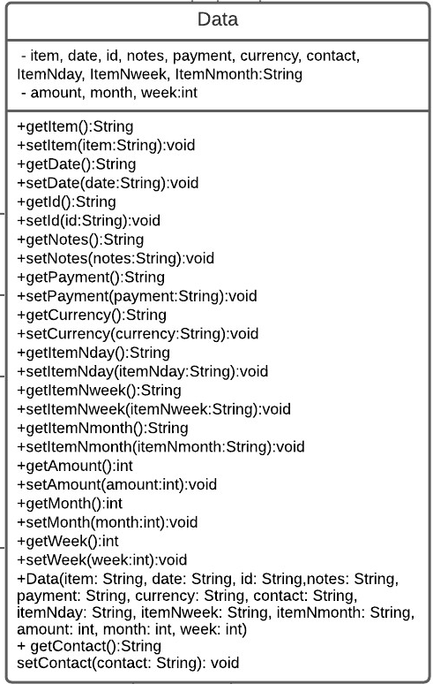
ISEE Project - Team DroidKnights
Milestone #3 - Advanced Prototype
Changes incorporated in the class diagram to accommodate new changes according to the new requirements

Slide 19
06
Working Prototype
ISEE Project - Team DroidKnights
Milestone #3 - Advanced Prototype
Recape of the basic prototype
New updates made to the app along with screen shots
App Working video

Slide 20
Short Recap
ISEE Project - Team DroidKnights
Milestone #3 - Advanced Prototype
Different Categories (House, Food, Transport…) Date of Expense Notes per entry Payment Option(Online, Card, etc.) Filters(day, week, month, item) | Deleting entries Icons for items Repeating Transactions Currency conversion Help menu Login id and password Logout button

Slide 21
New updates
ISEE Project - Team DroidKnights
Milestone #3 - Advanced Prototype
In this update we were able to implement the following features
Start screen with application introduction
Budget and spending's summary
Select currency in settings(Default currency)
Easy to enter numbers
Offline capability
Access to contacts
Show costs in chart
Computing average
Account information

Slide 22
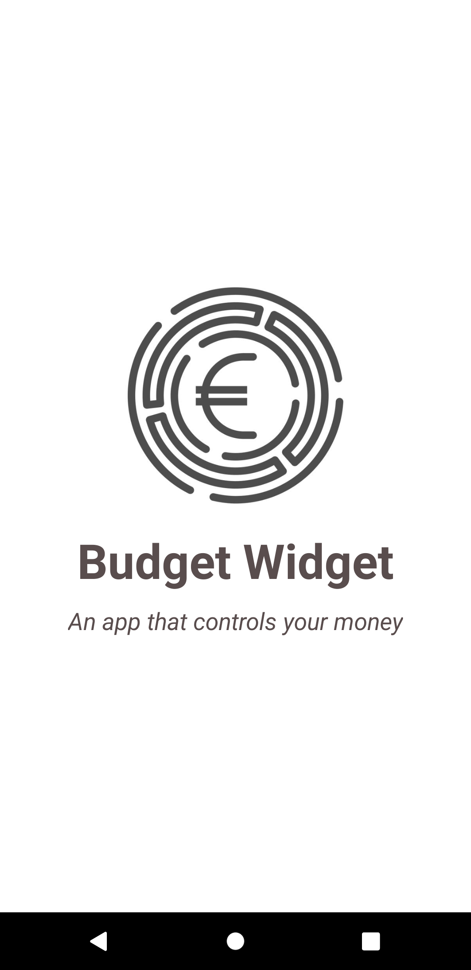
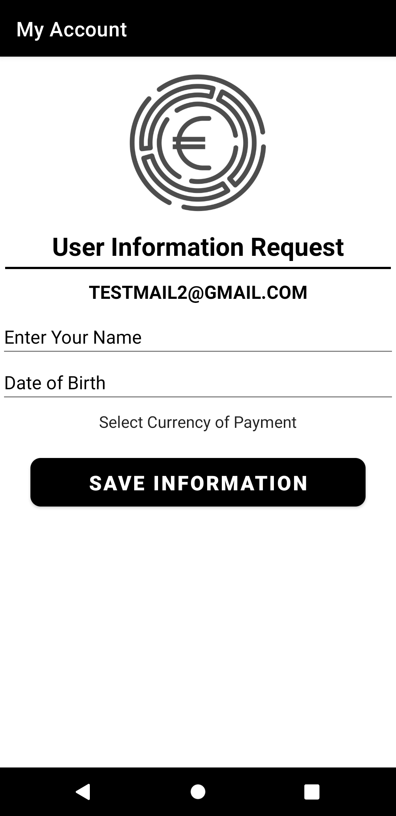
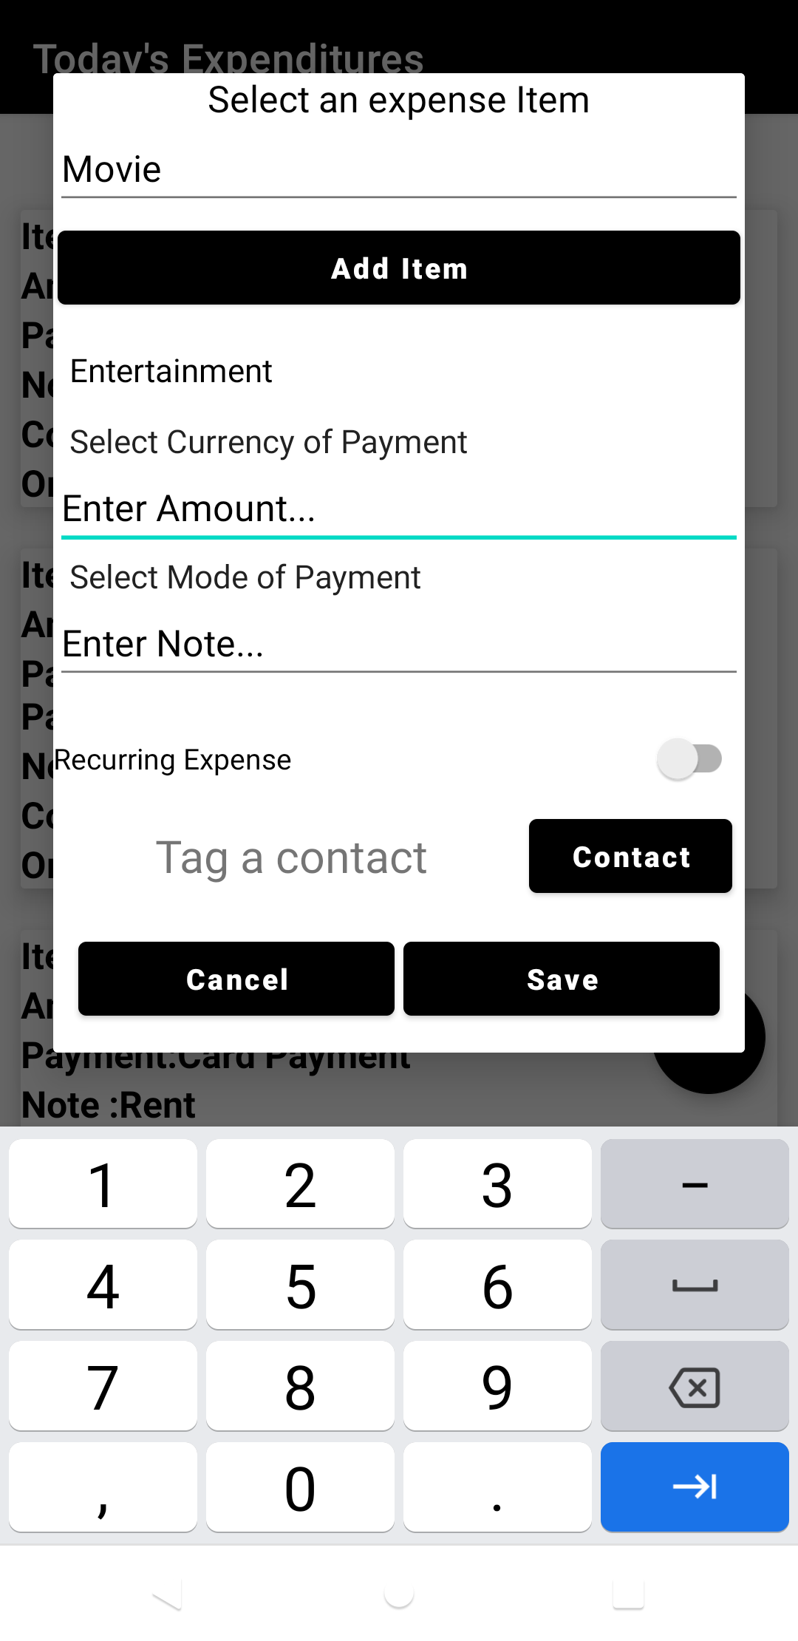
Updates
ISEE Project - Team DroidKnights
Milestone #3 - Advanced Prototype
Splash screen with app introduction
Add user details and
Select default currency
Access to contacts, Number pad while entering amount

Slide 23
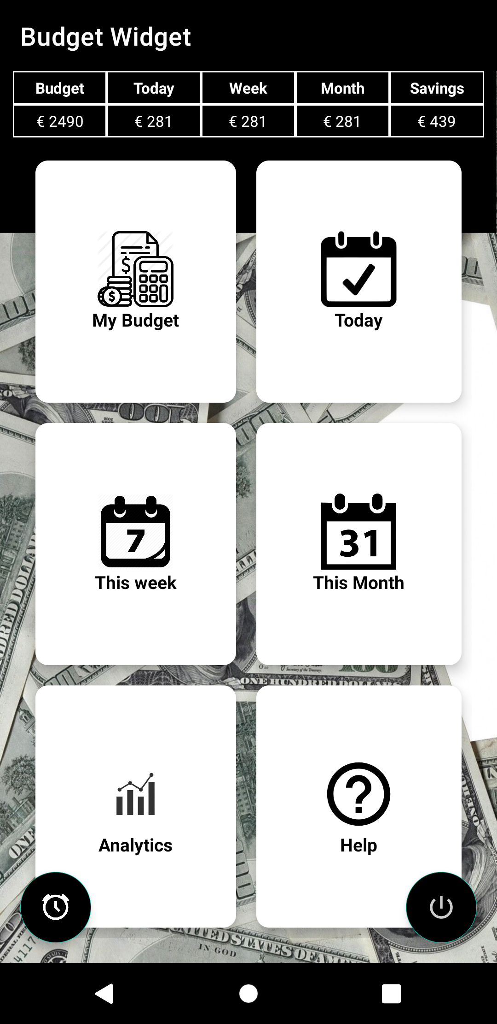
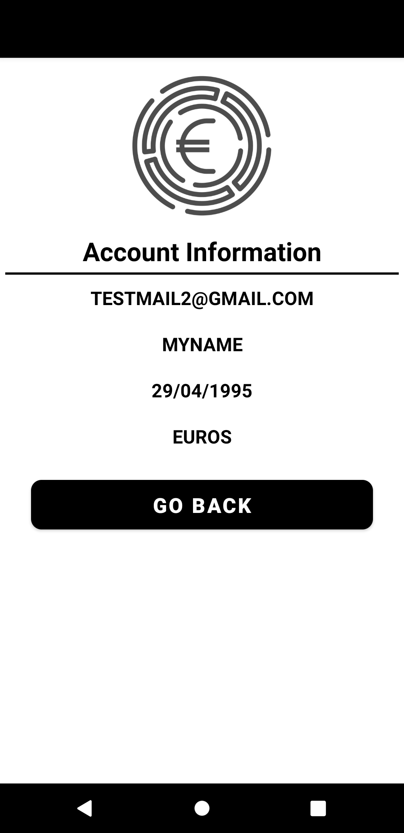
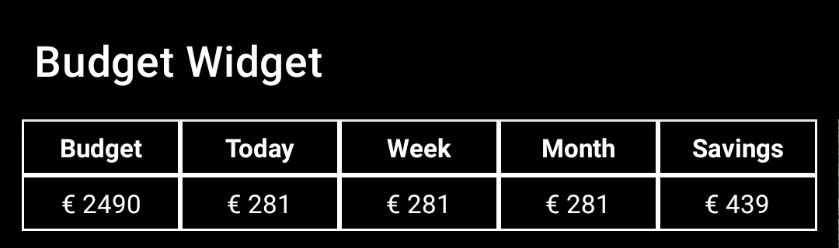
Updates
ISEE Project - Team DroidKnights
Milestone #3 - Advanced Prototype
Budget and spending’s summary
Provides user details

Slide 24
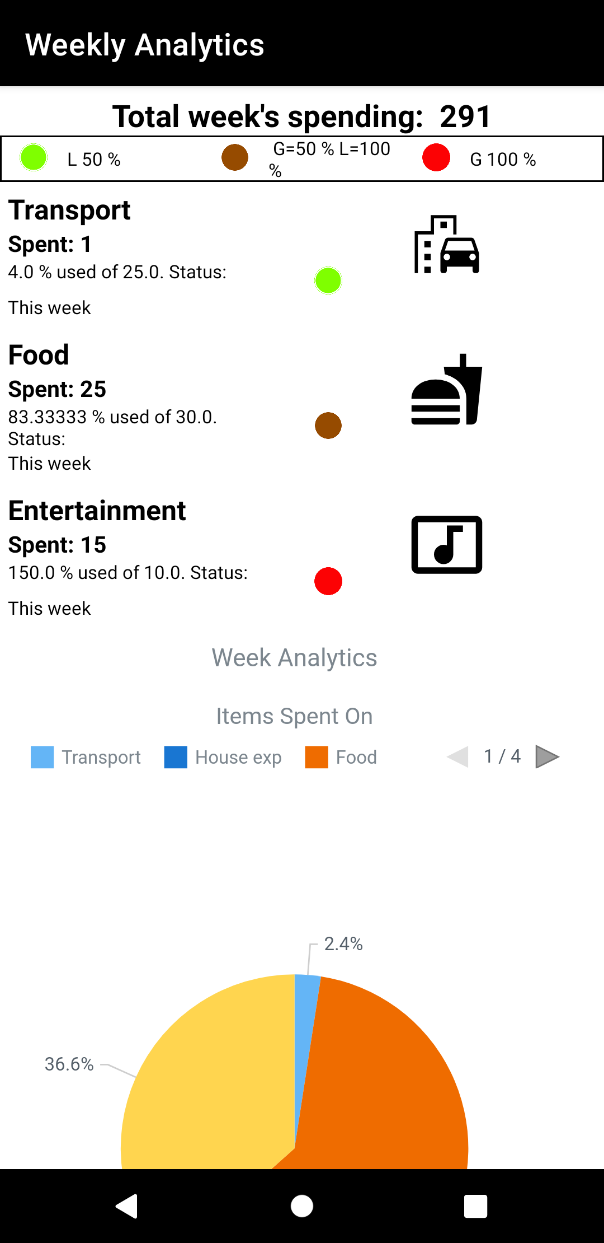
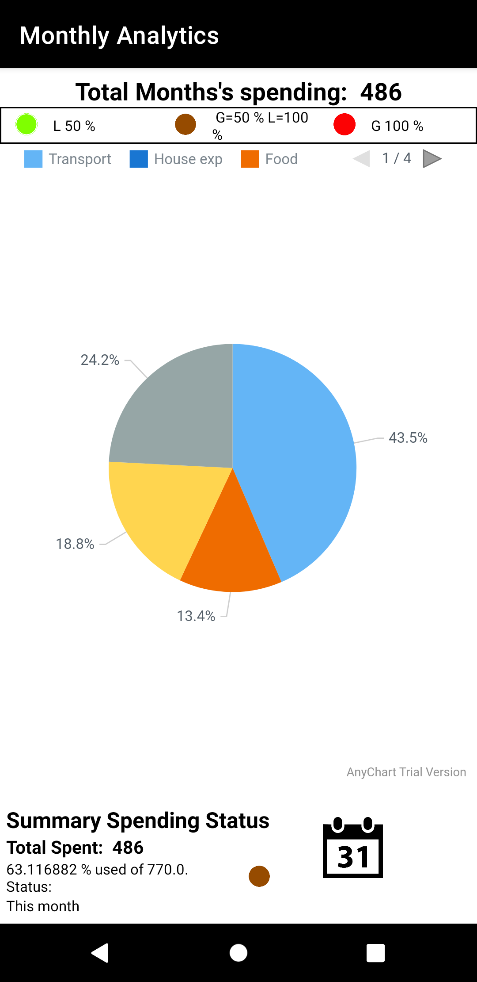
Updates
ISEE Project - Team DroidKnights
Milestone #3 - Advanced Prototype
Flags
Green : Spending is less than 50% of allocated amount
Brown: Spending is in between 50-100% of allocated amount
Red: Spending is greater than 100%of allocated amount
Pie chart graphically represents the amount of money user spend on each category
Summary spending status: Total spent, and Percentage of money spent from the total amount

Slide 25
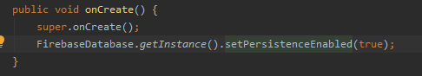
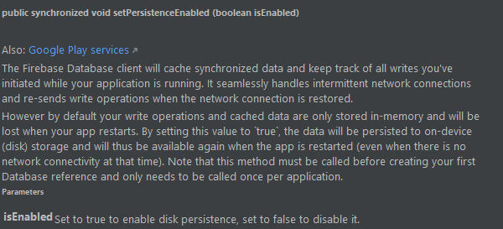
Offline capability
ISEE Project - Team DroidKnights
Milestone #3 - Advanced Prototype
The application will also work in offline mode. The data entered will be stored in local memory and sync up with firebase once the device comes online

Slide 26
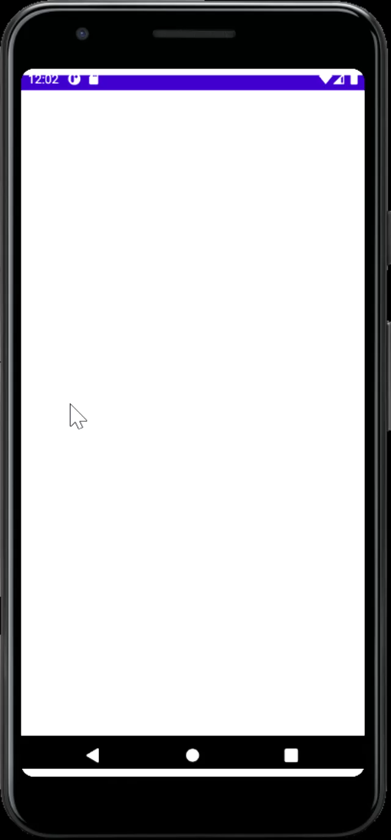
Working Video
ISEE Project - Team DroidKnights
Milestone #3 - Advanced Prototype

Slide 27
07
Thank you!
ISEE Project - Team DroidKnights
Milestone #3 - Advanced Prototype
Questions?

